Slide 1
Indoor Navigation System
Author:
Shengxiong Wu
Haocheng Wang

Slide 2
Introduction
Project overview:
Goal:
Develop an indoor navigation system that can navigate inside the building
Motivation:
Save time.
Contribute to the York University Community.
Context:
Google Map can not navigate inside the building.
Navigation system in the Mall required BIM(Building Information Model)
This software can navigate inside the building in the campus.
This software is web-based.

Slide 3
Software Development Life Cycle
Requirements Analysis
Design
Development
Testing
Deployment
Maintenance

Slide 4
Requirements Analysis

Slide 5
Design&Development
Backend
Spring boot
SQLite
Frontend
HTML
CSS
JS

Slide 6
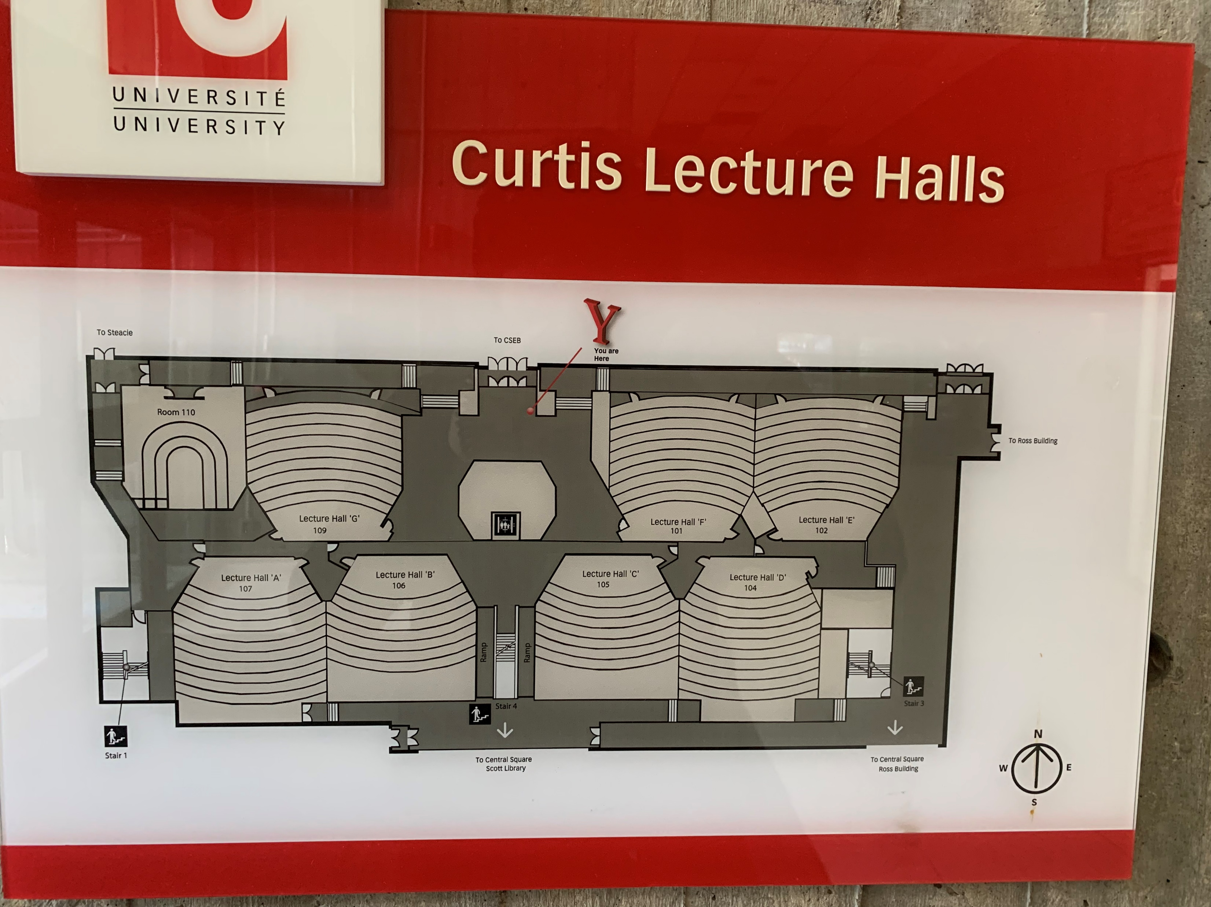
Floor Plan

Slide 7
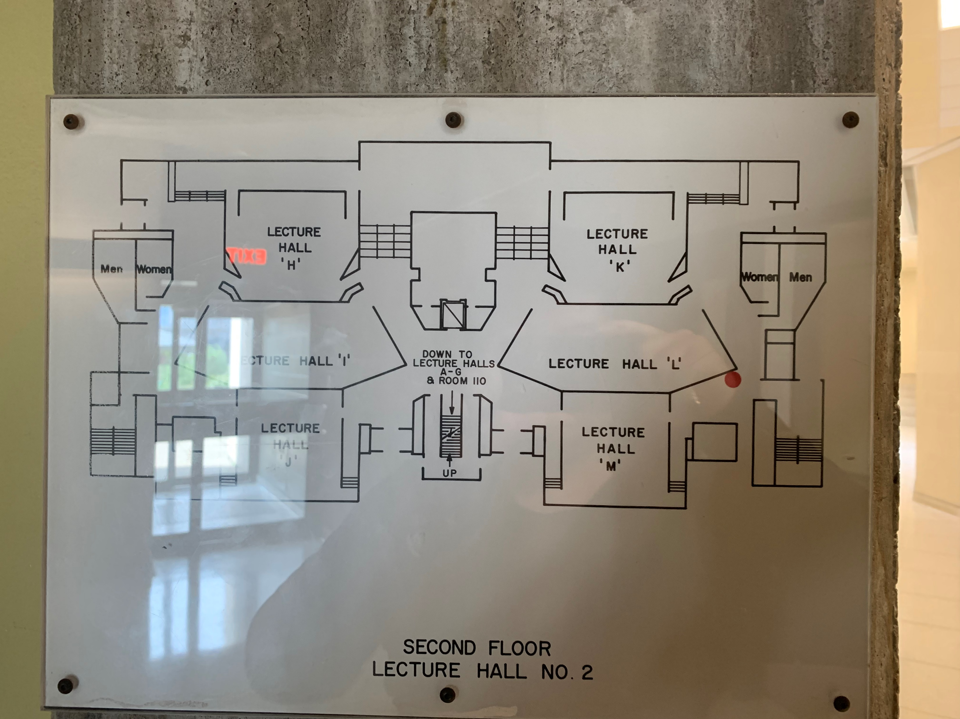

Slide 8
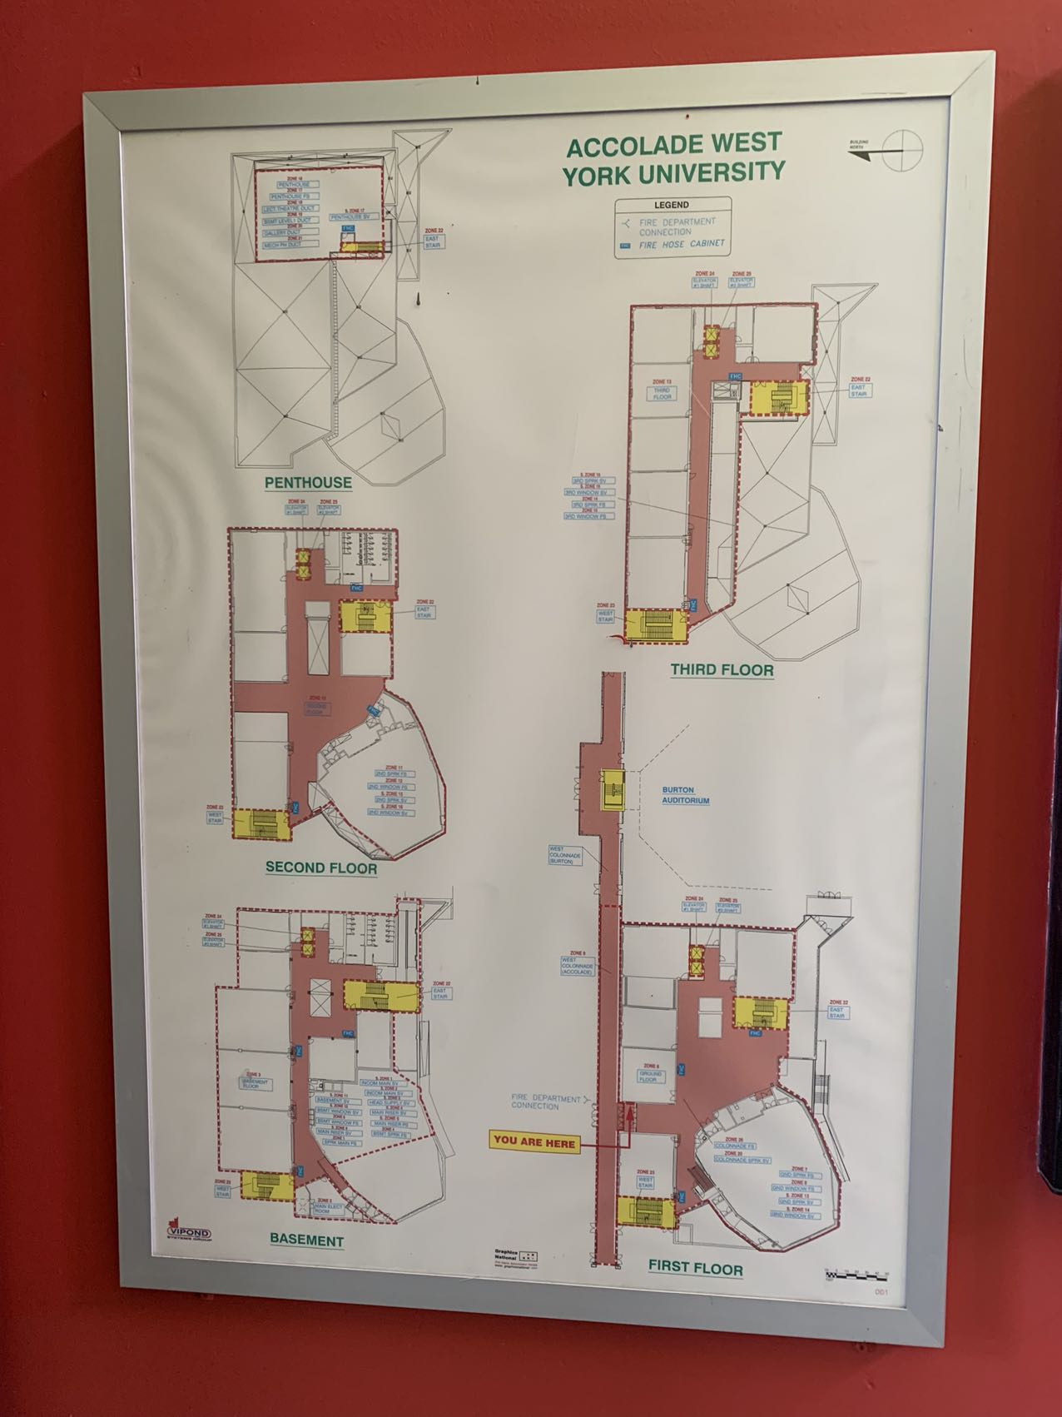
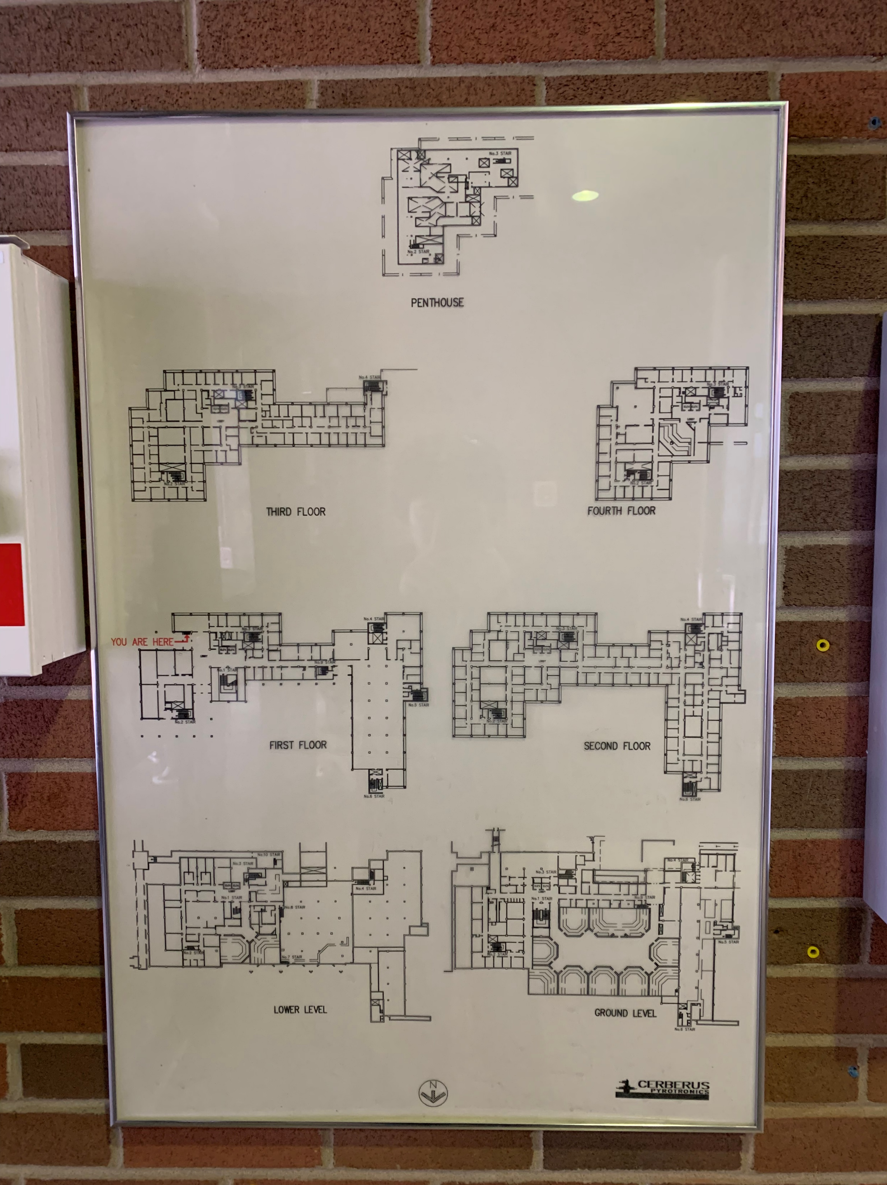

Slide 9
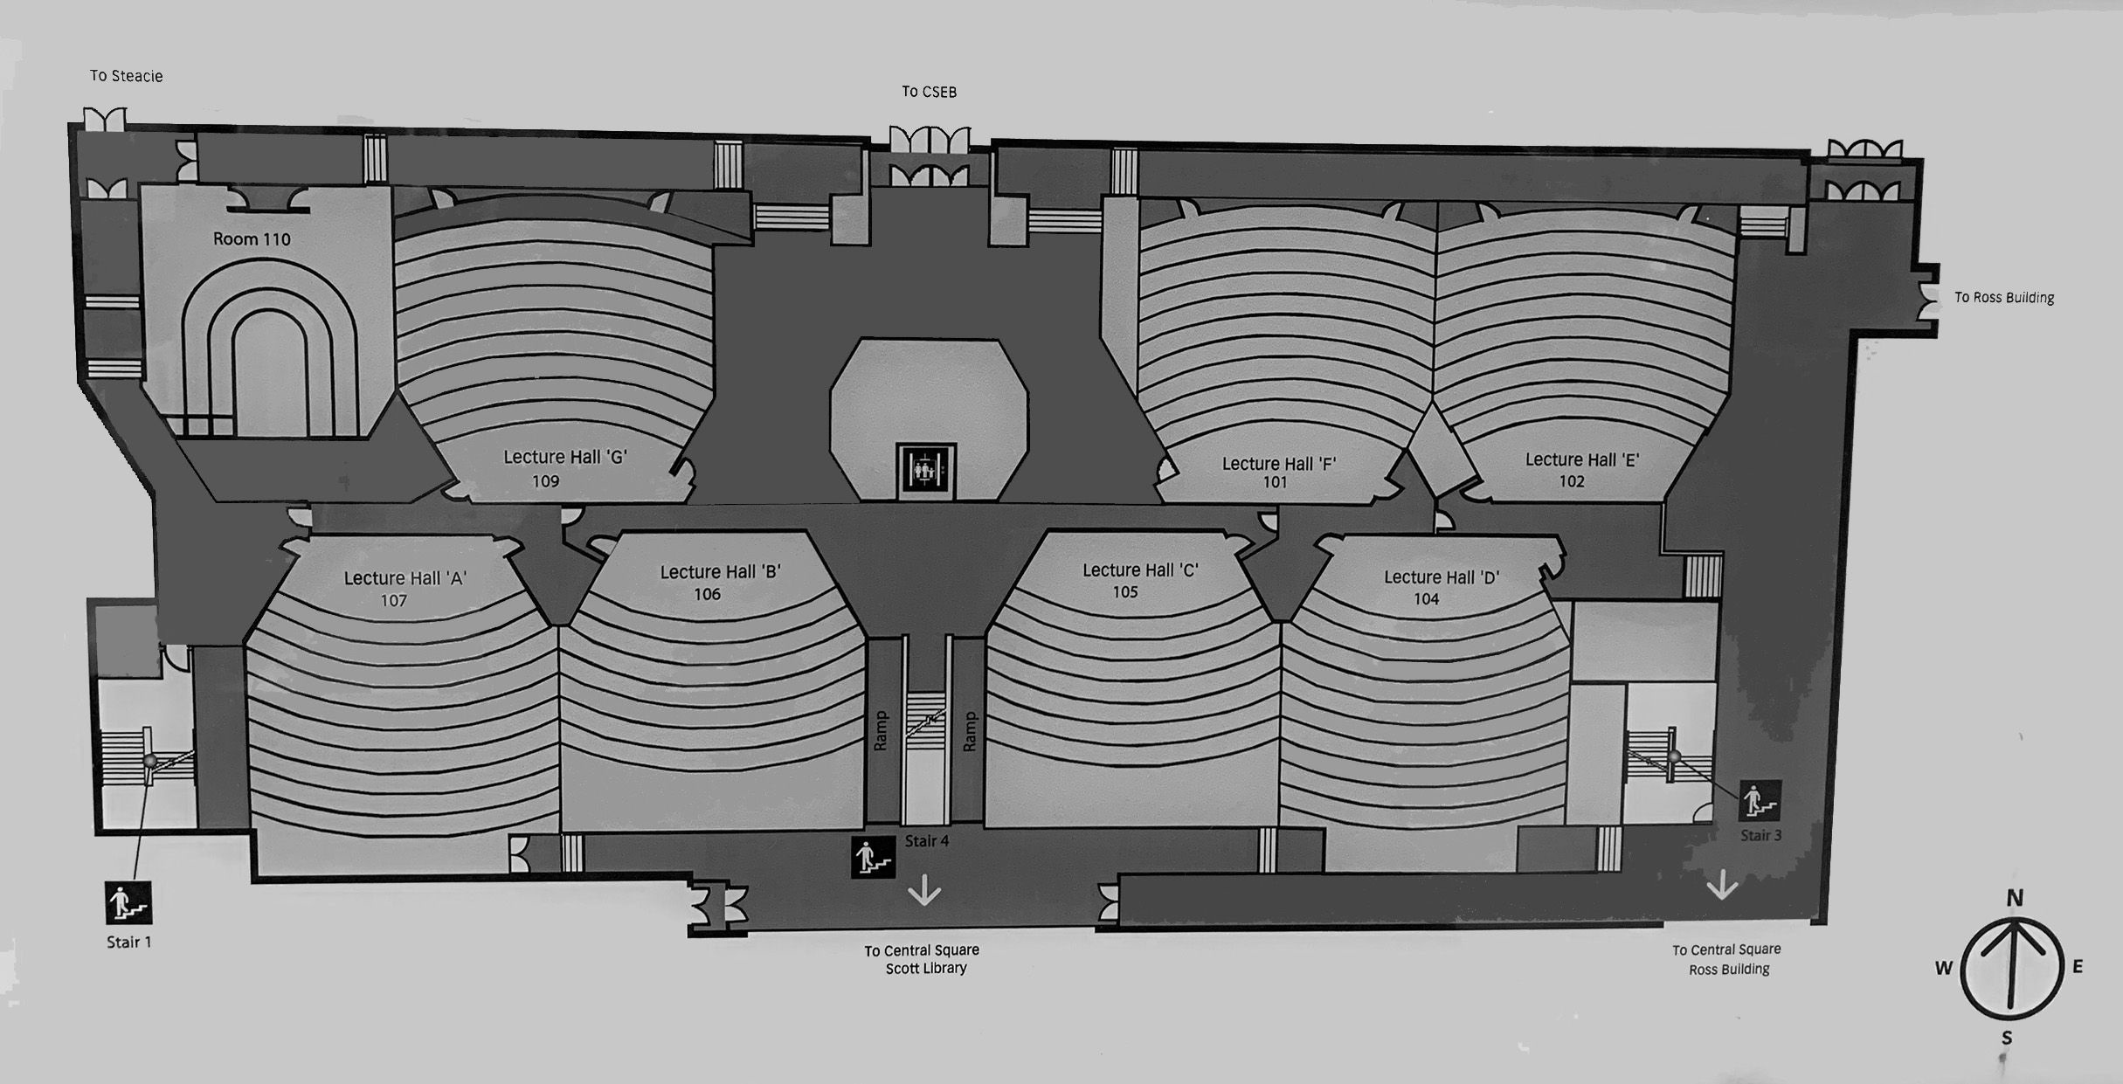
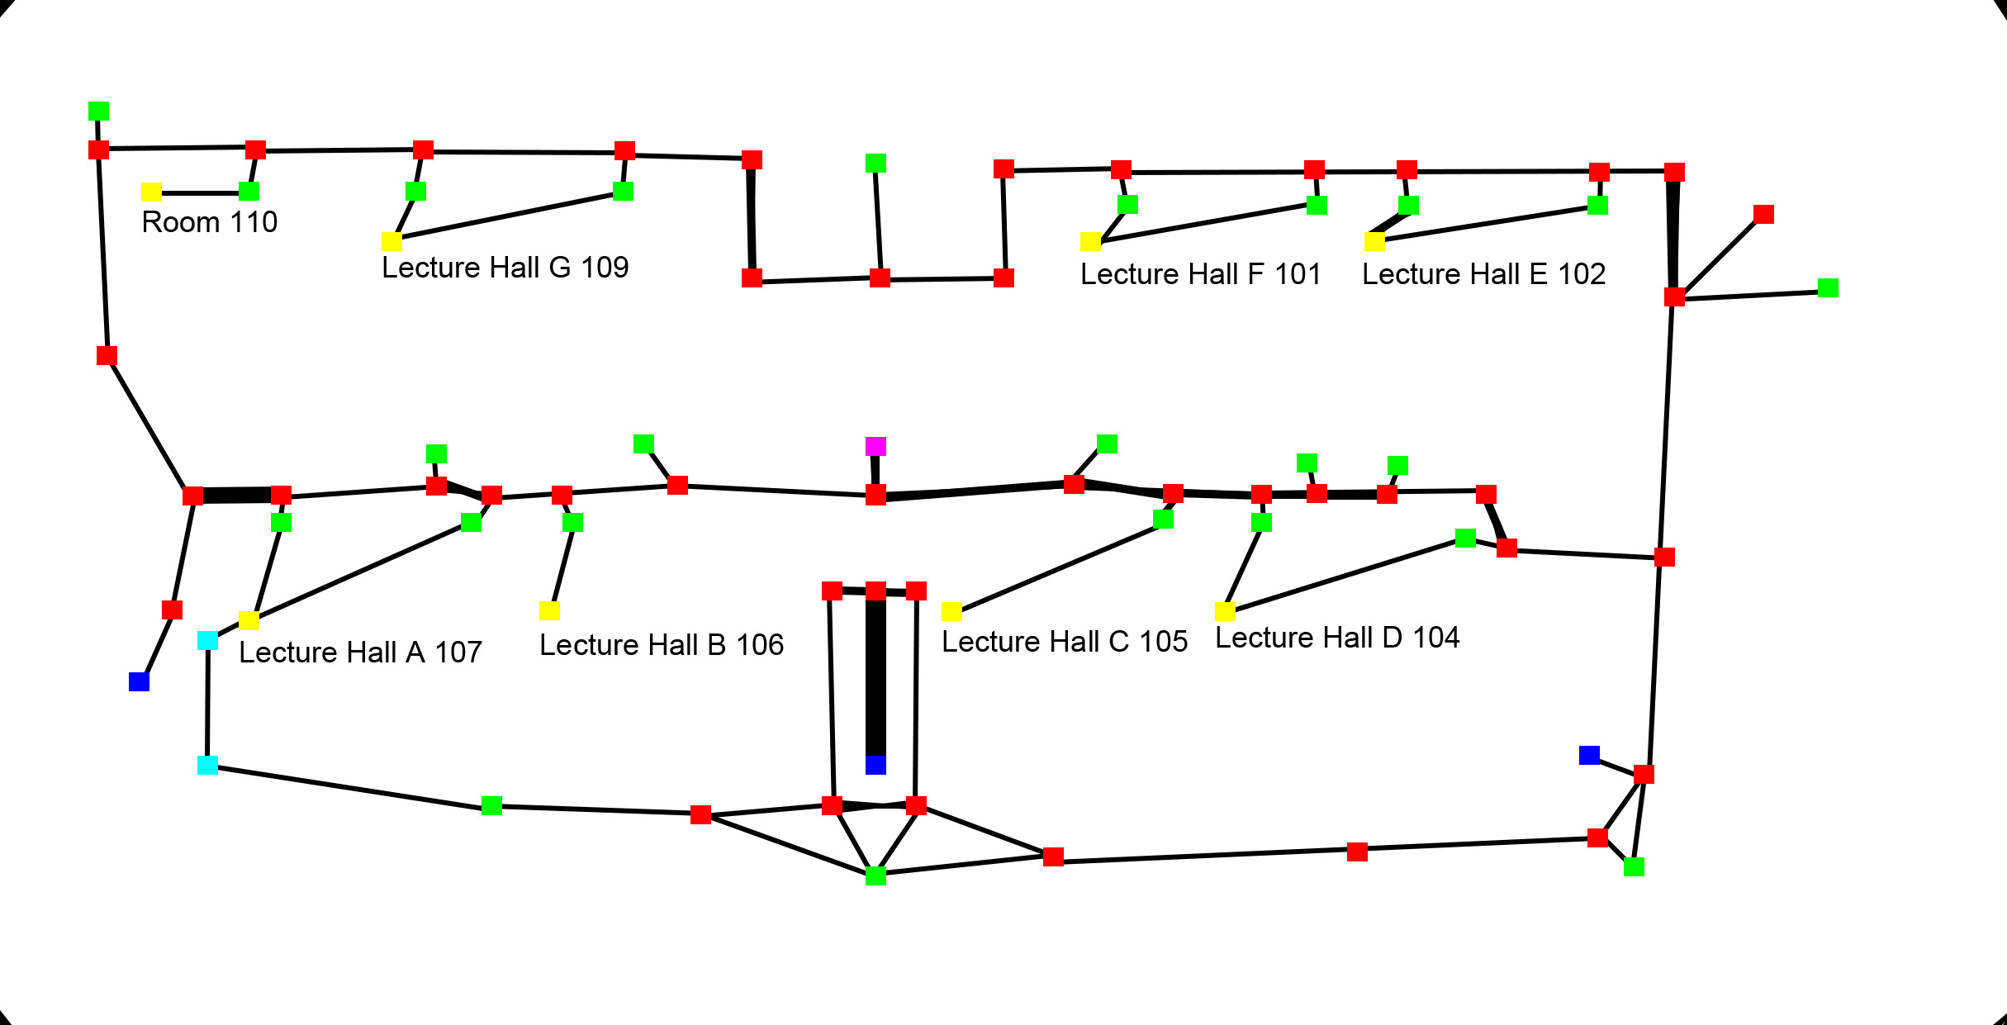
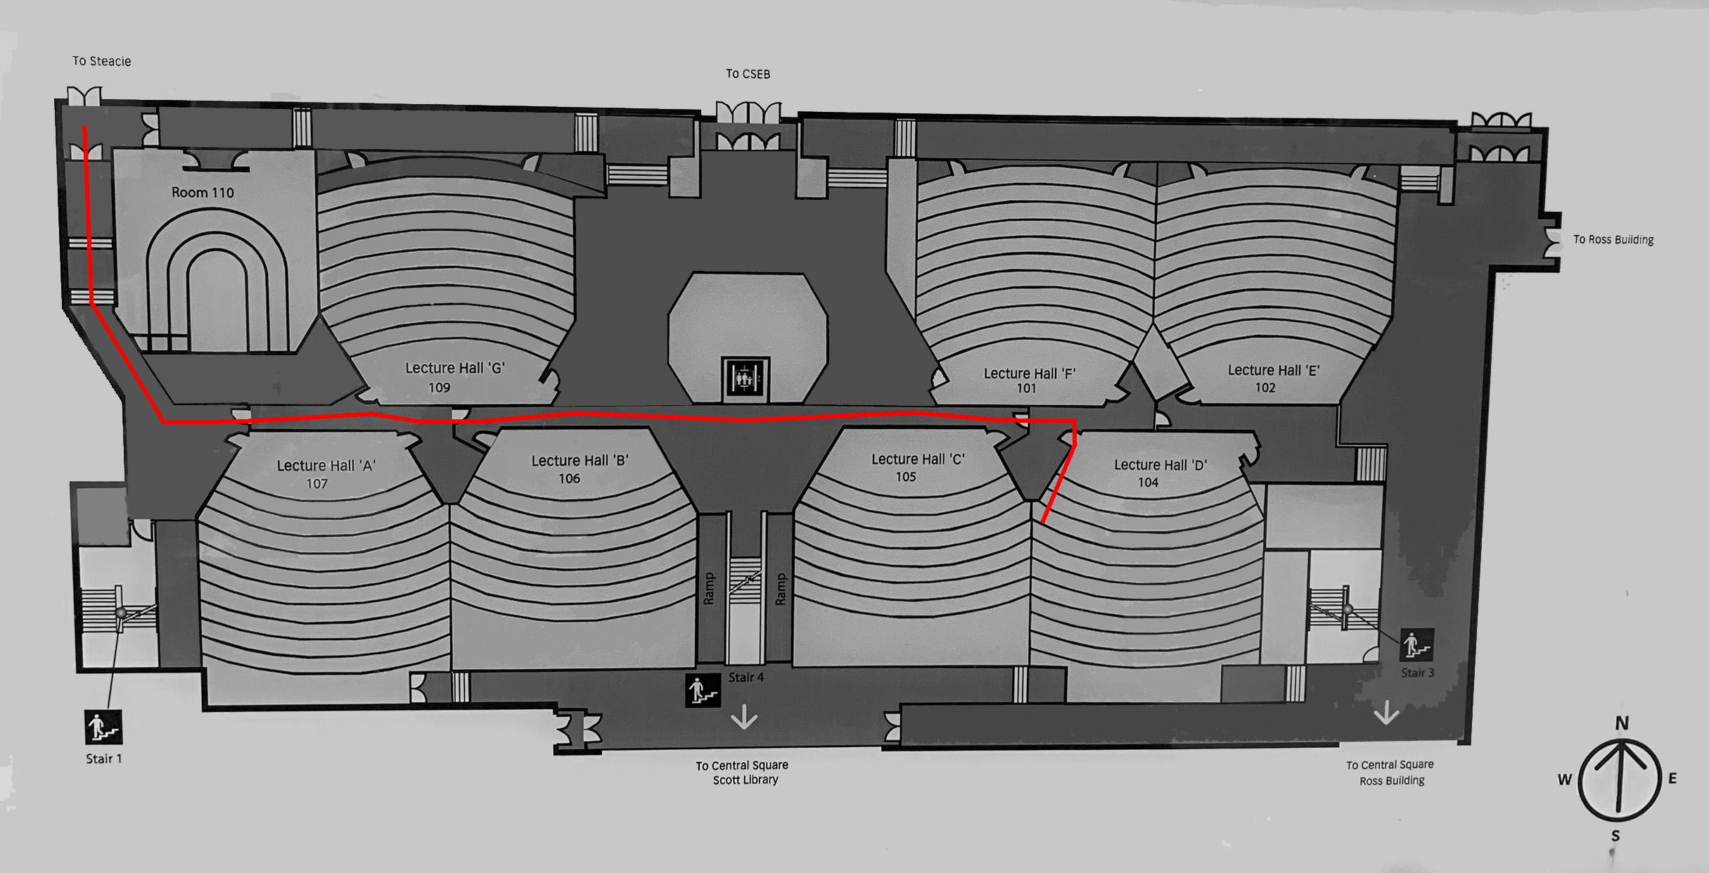
Proof of Concept

Slide 10
Help from Facilities Services/Campus Planning, Design & Construction
5 buildings

Slide 11
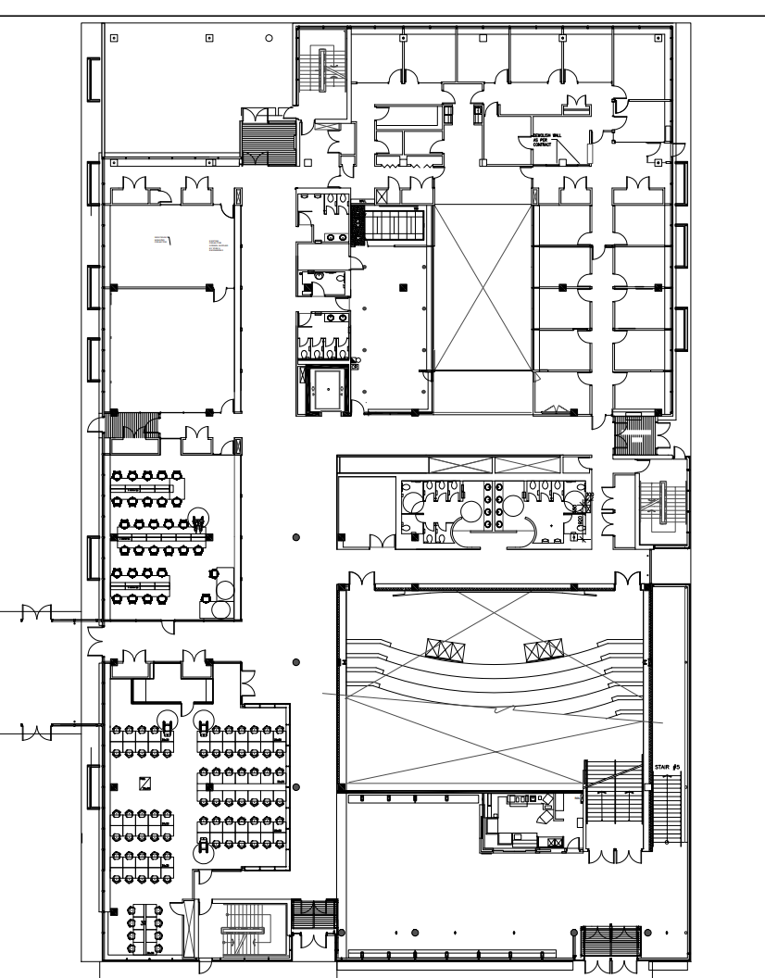
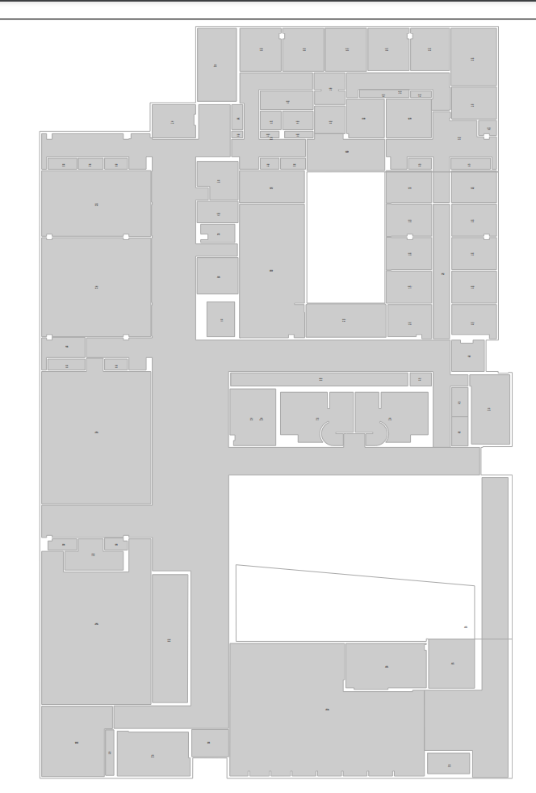
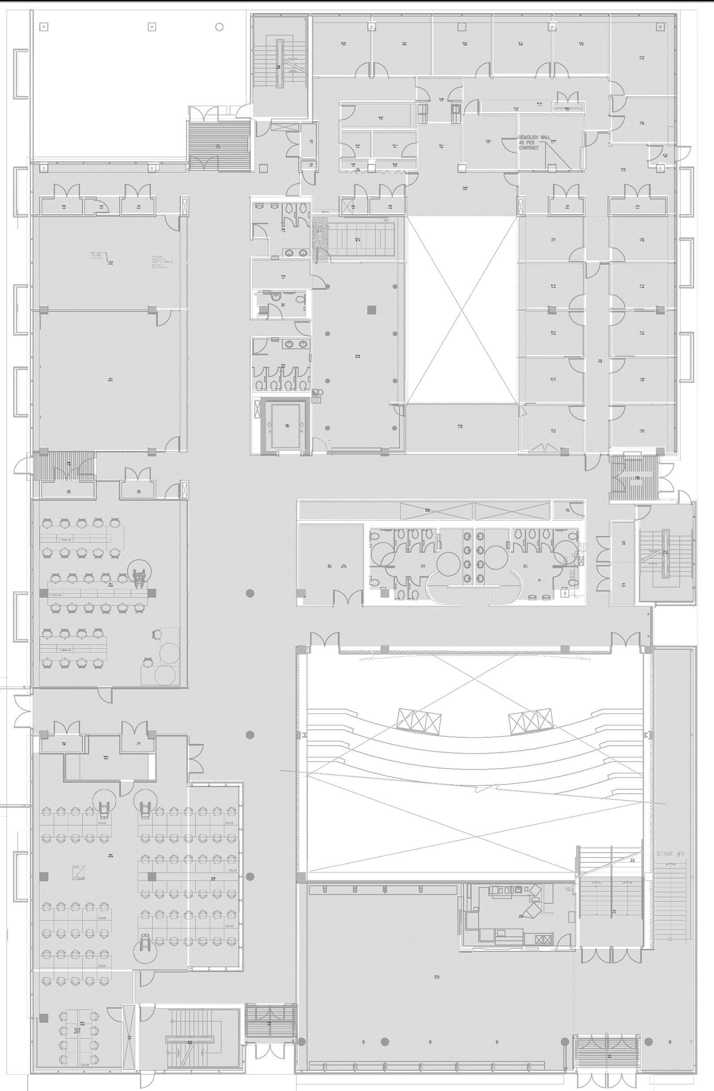
Digital Floor Plan

Slide 12
New Labelling Tool
Will introduce by Haocheng Wang later.

Slide 13
Testing

Slide 14
Deploy to Cloud
Will introduce by Haocheng Wang later.

Slide 15
Project Results
Completed software development and implemented all functional requirements.
Completed software development and implemented all functional requirements.

Slide 16
Future work
Using Deep Learning or other CV techniques to automatically extract and connect the nodes from floor plan.
Extract and connect the nodes by using robot in the building.

